Slide 1
Explorathon 2018
Using Computer Science to Make Games

Slide 2



Women in Computer Science

Slide 3
Careers in Computer Science
Software Engineer
Web Application Developer
Mobile Application Developer
Video Game Developer
...and so much more!
Today we will show you what its like to develop a video game and write real code!

Slide 4
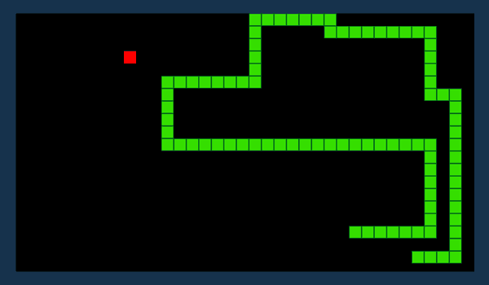
Our Inspiration
The game we will create today is based on the classic video game Snake.
We have also supplied a finished version of our game.

Slide 5
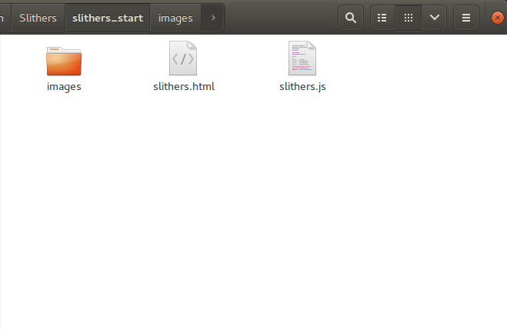
Open the Starter Project
Open up the file browser
Find the slithers_start folder in the flash drive
The initial setup of the project comes with:
  An HTML file that calls our code, and displays our game
  A JavaScript file that does all the work!
  A folder with all of our game images

Slide 6
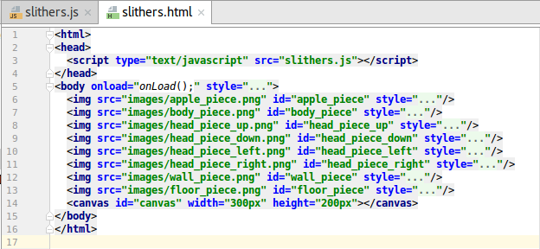
Our Simple HTML File
The canvas element is what we draw our game on
A function named “onLoad()” is called on the body during the “onload” event
We also load the different images we are going to use

Slide 7
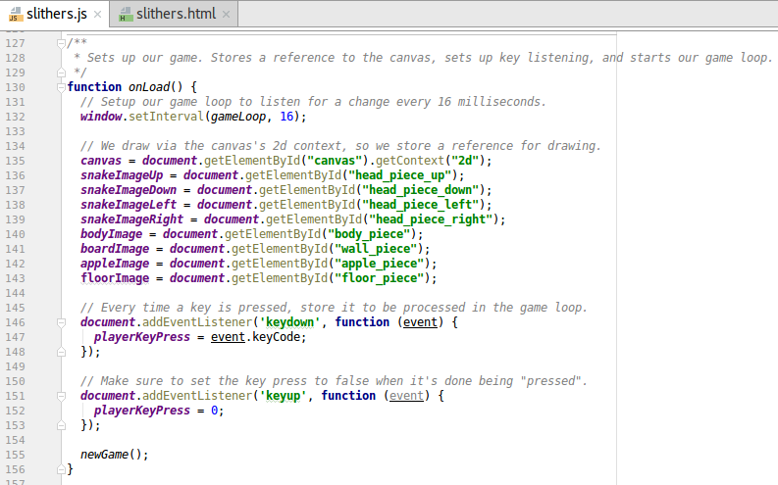
Our onLoad() Event
Toward the bottom of
our Javascript file,
we can see our
onLoad() function
The onLoad() function
initializes our game loop
Then, it prepares our
canvas, and gets ready
for us to draw
Next it loads all of the
different images we are
going to use
The code listens for key presses, and records the unique code
The gameLoop() function calls methods to handle input, update the position of our assets, and draw the game

Slide 8
Let's Draw Something
Find the function called drawGame() under our onLoad() function
The first thing we are going to do is draw our board
We will use a helper function to draw it
After we have written the code below in drawGame(), open the HTML file in the browser
drawArray(board, 0, 0);

Slide 9
What Does drawArray() Do?
The function drawArray() is a helper function we created to help us write less lines of code
The function takes in the array we want to draw, and the position on the canvas we want to draw it
function drawArray(drawArray, xOffset, yOffset) {
for (var x = 0; x < drawArray[0].length; x++) {
for (var y = 0; y < drawArray.length; y++) {
var value = drawArray[y][x];
var image;
if (value == 0) {
image = floorImage;
}
if (value == -1) {
image = boardImage;
}
canvas.drawImage(image, (x + xOffset) * 8, (y + yOffset) * 8);
}
}
}

Slide 10
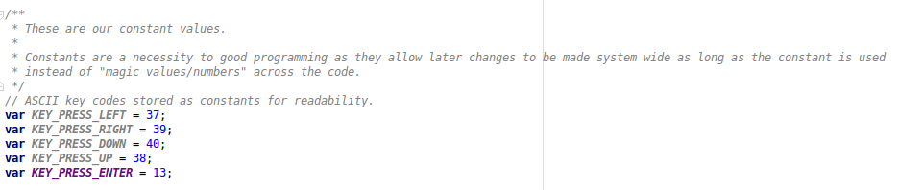
Variables
At the top of our file are a lot of variables
Constants are numbers that never change
We are using all of these constants to track which keyboard key was pressed

Slide 11
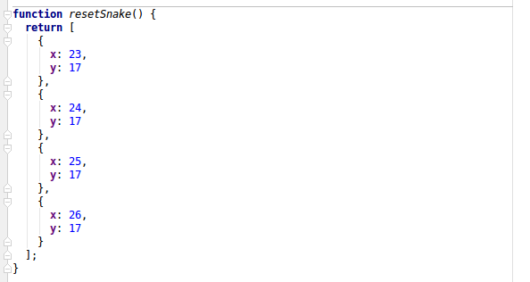
Storing snake segment positions
We can store a lot of different information under snake as properties
The properties help to keep track of where they are on the board, and how many segments there are
Our snake properties are already loaded with their starting positions
We access the properties like this: snake[0].x

Slide 12
How to Draw the Snake
Now that we know where the snake’s positions are stored, we can write the drawing code!
Under the code we wrote for the game board, we are going to write the three lines shown below
We need a different image for the head, and for the rest of the body
After we write this code, we can refresh our HTML file in the browser
for (var x = 0; x < snake.length; x ++) {
var image;
if (x == 0) {
image = snakeImageLeft;
}
else {
image = bodyImage;
}
canvas.drawImage(image, snake[x].x * 8, snake[x].y * 8);
}

Slide 13
Drawing the Apple
Our apple is very similar to our snake
The apple attributes are also saved in a game state variable towards the top of the file
The apple has properties for it’s x and y positions
After we add the following line of code, we can refresh our browser
canvas.drawImage(appleImage, applePosition.x * 8, applePosition.y * 8);

Slide 14
Time to Make Things Move
In Snake, we can move our snake’s head all around the board, and the body follows
The next step is to check key presses, and change our snake’s position based on that
Before we write our code, we need to review Cartesian coordinates

Slide 15
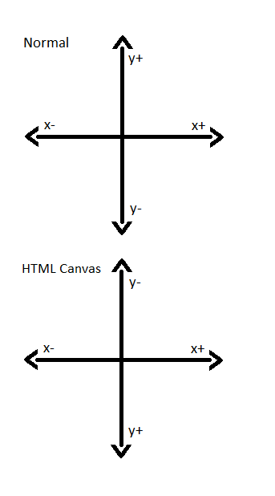
Coordinates - Quick Review
We can move things around on the screen according to x and y positions
Because positive y is downward, when we press down we want to increase our snake’s y property
When we press up, we want to decrease our snake’s y property
When we press right, we want to increase our snake’s x property
When we press left, we want to decrease our snake’s x property

Slide 16
Make Things Move
Go to the handleInput() function above the drawGame() function
We are going to determine which key is pressed, then change our snake’s position based on that
Our unique codes for the key presses are already saved for us
  KEY_PRESS_UP
  KEY_PRESS_DOWN
  KEY_PRESS_LEFT
  KEY_PRESS_RIGHT
if (playerKeyPress == KEY_PRESS_LEFT) {
xDelta --;
}
if (playerKeyPress == KEY_PRESS_RIGHT) {
xDelta ++;
}
if (playerKeyPress == KEY_PRESS_DOWN) {
yDelta ++;
}
if (playerKeyPress == KEY_PRESS_UP) {
yDelta --;
}

Slide 17
Applying Our New Position
Once we have our new snake position, the first thing we should do is reset our key press tracker
Next, we should move the snake body, then apply the new position to the snake’s head
Once we write this new code, we can refresh our browser
playerKeyPress = 0;
moveSnakeBody(xDelta, yDelta);
snake[0].x += xDelta;
snake[0].y += yDelta;

Slide 18
Moving Our Snake’s Head
Our snake head looks weird! He should look in the direction he’s heading
We need to keep track of the last position during key presses
Add the yellow highlighted code
if (playerKeyPress == KEY_PRESS_LEFT) {
lastSnakeDirection = "left";
xDelta --;
}
if (playerKeyPress == KEY_PRESS_RIGHT) {
lastSnakeDirection = "right";
xDelta ++;
}
if (playerKeyPress == KEY_PRESS_DOWN) {
lastSnakeDirection = "down";
yDelta ++;
}
if (playerKeyPress == KEY_PRESS_UP) {
lastSnakeDirection = "up";
yDelta --;
}

Slide 19
Draw a New Snake Head
Next, we need to edit our snake drawing code in drawGame()
We can check the lastSnakeDirection variable to see which image we want to draw
Once we add the code in the next slide, we can refresh the browser to see our changes

Slide 20
Code for Snake Head
for (var x = 0; x < snake.length; x ++) {
var image;
if (x == 0) {
if (lastSnakeDirection == “left”) {
image = snakeImageLeft;
}
if (lastSnakeDirection == "right") {
image = snakeImageRight;
}
if (lastSnakeDirection == "up") {
image = snakeImageUp;
}
if (lastSnakeDirection == "down") {
image = snakeImageDown;
}
}
else {
image = bodyImage;
}
canvas.drawImage(image, snake[x].x * 8, snake[x].y * 8);
}

Slide 21
Eat & Regen Apple

Slide 22
Grow the Body

Slide 23
Regen the Apple

Slide 24
Steps to Finish Your Game
Finish updating the paddles so they stay inside the board
Draw a green line above and below the board
Draw a dotted line down the middle of the board
Update all of the math to account for the extra green lines on the top and bottom of the board
Please keep an eye on https://github.com/hillylew/Slithers for additions to this tutorial

Slide 25
Thank you!
Included on your flash drive are the following programs
  Notepad++ – a text editor with syntax highlighting, good for writing code
  Gimp – A free and open source image editor
  Audacity – A free sound editing program
  Reaper – A digital audio workstation program providing convenient licensing
  Blender – A free and open source 3d modeling tool
  Tiled – A free and open source Tile Map editing tool, used for creating complex levels
Please visit https://github.com/hillylew/Slithers for future updates to this project or to help in its development. Snake is a GPL'd open source project that anyone can contribute to!
We hope you enjoyed Snake!

